Slide 1
CYBERSECURITY PHISING AWARENESS PROJECT
EMMANUEL ADEMOYEGA
CA/DF1/233492
August 19, 2026

Slide 2
INTRODUCTION
Every day, individuals and organizations are targeted by cybercriminals who rely not on breaking through firewalls, but on tricking people into opening the door themselves. Phishing emails, fraudulent websites, and social engineering tactics remain among the most common and successful attack methods used today, precisely because they exploit trust, urgency, and human error rather than technical vulnerabilities.
This project explores how to recognize phishing emails and fake websites, understand the psychological tactics attackers use to manipulate victims, and adopt practical habits that reduce the risk of falling victim to these schemes.

Slide 3
OBJECTIVES OF THIS PROJECT
Explain how to recognize phishing emails and fake websites.
Educate readers about the social engineering tactics used by attackers.
Provide practical best practices and tips to avoid falling victim.
Reinforce learning with real-world examples and an interactive quiz.

Slide 4
RECOGNISING PHISING EMAILS AND FAKE WEBSITES
Phishing is a form of cyberattack in which criminals impersonate legitimate organizations or individuals usually through email, text message, or a fake website in order to trick victims into revealing sensitive information such as passwords, banking details, or personal identification numbers. Although phishing attempts vary in sophistication.
Anatomy of a Phishing Email
Below shows how to spot these signals quickly is the first line of defense against email-based fraud.

Slide 5
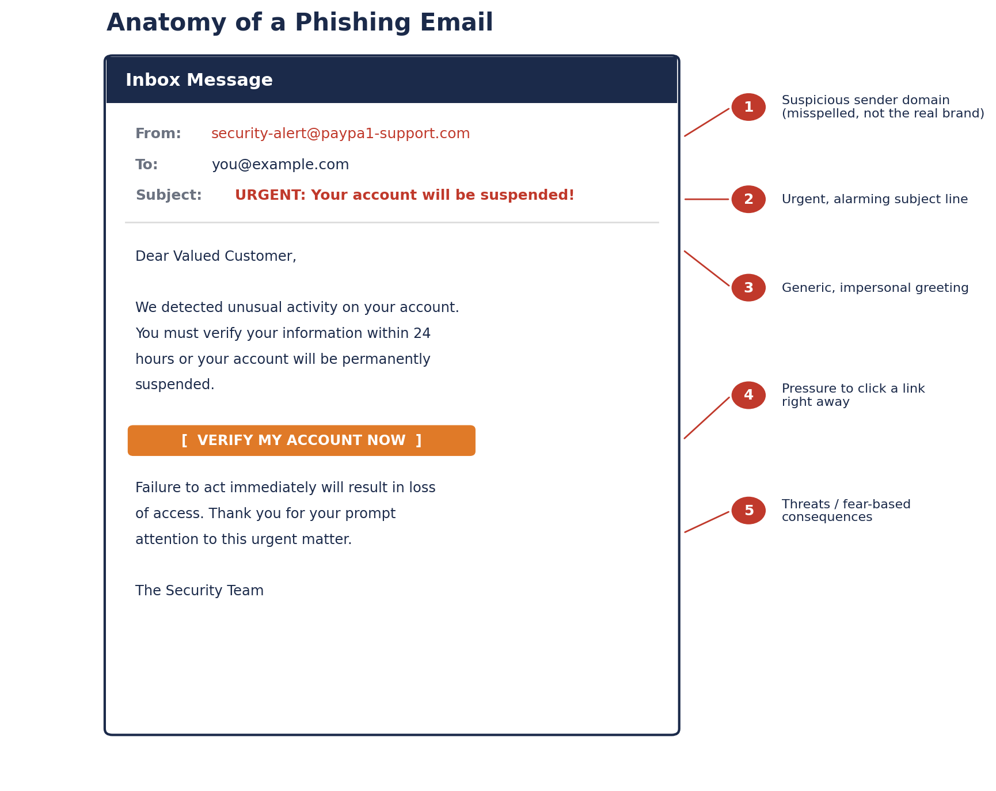

Slide 6
Red Flags in Suspicious Email
Warning Sign | What to Look For
Sender address | Domain is misspelled, uses free email services, or does not match the organization's real domain.
Urgency or threats | Messages that pressure you to act “immediately” or threaten account suspension, fines, or legal action.
Generic greetings | “Dear Customer” or “Dear User” instead of your actual name.
Suspicious links | Hyperlinked text that does not match the actual URL when hovered over.
Unexpected attachments | Files you did not request, especially .exe, .zip, or macro-enabled documents.
Requests for sensitive data | Legitimate organizations rarely ask for passwords, PINs, or full card numbers by email.
Poor spelling/grammar | Frequent typos or awkward phrasing, often a sign of a non-official source.
Too-good-to-be-true offers | Unexpected prizes, refunds, or lottery winnings requiring “verification” first.

Slide 7
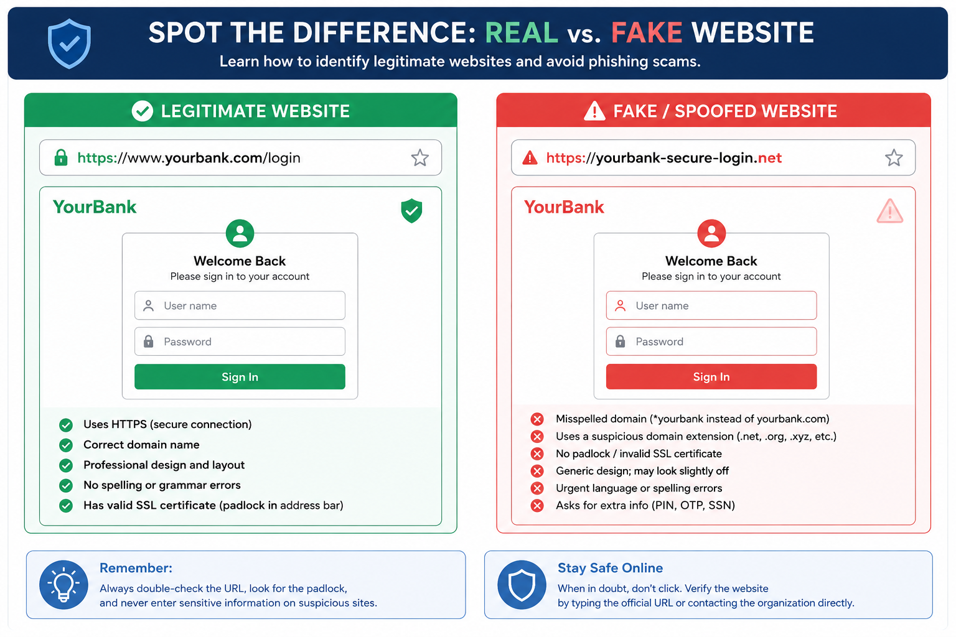
Recognizing Fake Website
Fake or 'spoofed' websites are designed to closely imitate legitimate ones often to harvest login credentials or payment information. The comparison below highlights the key differences between a genuine website and a fraudulent copy.

Slide 8
HOW TO VERIFY A GENUINE WEBSITE
Check the URL carefully for misspellings, extra words, or unusual domain extensions (e.g., .net instead of .com).
Look for “https://” and a padlock icon in the address bar, indicating an encrypted connection.
Hover over links before clicking to preview the actual destination URL.
Be cautious of sites with poor grammar, low-resolution logos, or inconsistent formatting.
Never enter sensitive information (PIN, OTP, full card number) on a site reached via an unsolicited email or text link.
When in doubt, type the organization's website address directly into the browser instead of clicking a link.

Slide 9
SOCIAL ENGINEERING TATICS
Social engineering is the art of psychological manipulation used to trick people into breaking normal security procedures, divulging confidential information, or granting unauthorized access. Rather than exploiting software vulnerabilities, attackers exploit human tendencies such as trust, fear, curiosity, and the desire to be helpful.

Slide 10
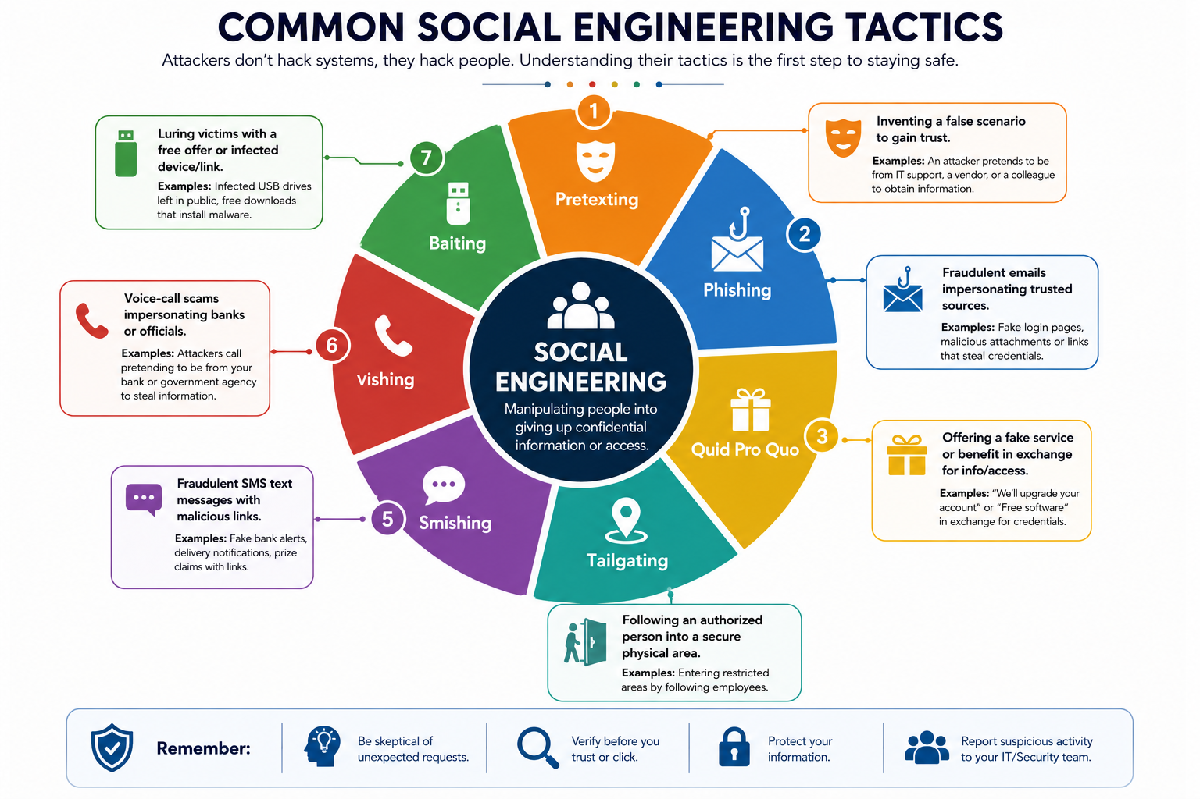

Slide 11
COMMON TATICS EXPLAINED
Phishing : mass or targeted fraudulent emails impersonating trusted organizations to steal credentials or spread malware.
Pretexting : the attacker fabricates a believable scenario (e.g., posing as IT support or a bank official) to gain the target's trust and extract information.
Baiting : victims are lured with a tempting offer, such as a free download or a USB drive left in a public place, that installs malware once accessed.
Vishing (voice phishing) : phone calls impersonating banks, government agencies, or tech support to pressure victims into revealing information.
Smishing (SMS phishing) : fraudulent text messages containing malicious links or urgent requests.
Tailgating / Piggybacking : an attacker physically follows an authorized employee into a restricted area without proper credentials.
Quid Pro Quo : attackers offer a fake service or benefit (e.g., “free IT support”) in exchange for login credentials or system access.

Slide 12
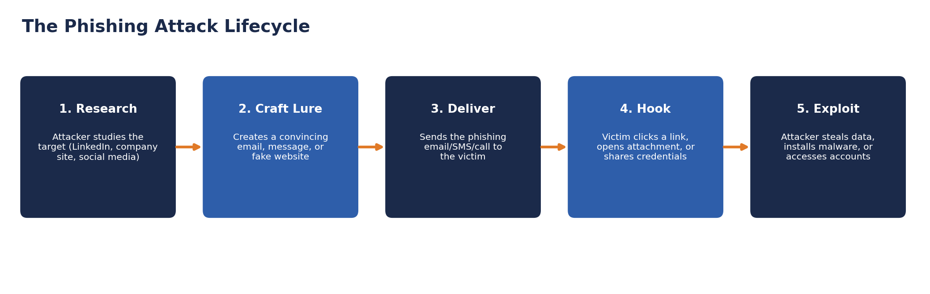
THE PHISING ATTACK LIFE-CYCLE
Understanding how an attack unfolds : from reconnaissance to exploitation. This helps explain why these tactics are so effective and where individuals can intervene to stop them.

Slide 13
WHY THESE TATICS WORK
Social engineering succeeds because it targets predictable human responses rather than technical flaws. Examples
Authority : people tend to comply with requests that appear to come from a boss, bank, or government agency.
Urgency and fear: pressure to act quickly reduces careful judgment and increases the likelihood of mistakes.
Trust and familiarity : messages that mimic known brands or colleagues lower a victim's guard.
Curiosity and reward : offers of free items, prizes, or exclusive information motivate victims to click without thinking.

Slide 14
BEST PRACTICE AND TIPS TO AVOID FALLING VICTIMS
While attackers continue to refine their methods, a small set of consistent habits dramatically reduces the risk of falling victim to phishing and social engineering attacks.
Do | Don't
Verify sender identity through a separate, trusted channel. | Don't click links or open attachments from unknown or unexpected senders.
Hover over links to preview the actual URL before clicking. | Don't enter login credentials on a page reached through an email link.
Report phishing attempts to your organization's security team. | Don't respond to unsolicited requests for personal or financial information.
Use strong, unique passwords and a password manager. | Don't reuse the same password across multiple accounts.
Enable multi-factor authentication wherever available. | Don't disable security warnings or pop-up blockers to “save time.”
Keep operating systems and applications updated. | Don't ignore software update prompts for extended periods.
Take time to verify urgent requests, even from “colleagues.” | Don't let urgency or fear rush you into an immediate decision.

Slide 15
REAL WORD EXAMPLE
Example 1: The Google and Facebook Invoice Scam (2013–2015)
A Lithuanian national orchestrated a business email compromise scheme that impersonated a hardware manufacturer both companies worked with. By sending convincing fake invoices and forged corporate documents, the scammer tricked employees at both companies into wiring over $100 million to fraudulent bank accounts before the scheme was uncovered. This case demonstrates how attackers combine pretexting with document forgery to defeat even sophisticated corporate finance controls.
Example 2: The 2020 Twitter Verified-Account Breach
Attackers used vishing phone-based social engineering to impersonate IT staff and trick Twitter employees into revealing credentials for internal administrative tools. With that access, the attackers hijacked dozens of high-profile verified accounts to promote a cryptocurrency scam. The incident highlighted how a single successful social engineering call can bypass otherwise strong technical defenses.
Example 3: The Target Corporation Data Breach (2013)
Attackers gained an initial foothold by phishing credentials from a third-party HVAC vendor with network access to Target's systems. From that entry point, they moved laterally into point-of-sale systems and stole roughly 40 million customers' payment card details. The breach illustrates how phishing a single, less-guarded vendor can compromise an entire enterprise supply chain.

Slide 16
INTERACTIVE ASSESMENT QUIZ
Question 1: You receive an email from “Appl3-Support@icloud-verify.com” claiming your account has been locked and asking you to click a link to verify your identity within 1 hour. What should you do first?
A. Click the link immediately to avoid losing access
B. Reply to the email asking for more details
C. Check the sender's domain and go directly to Apple's official website instead of clicking the link
D. Forward the email to a friend for a second opinion
Question 2: A caller claiming to be from your company's IT department asks for your network password to “fix an urgent security issue.” This is an example of which social engineering tactic?
A. Baiting
B. Vishing / Pretexting
C. Tailgating
D. Quid Pro Quo
Question 3: Which of the following is the strongest indicator that a website may be fake?
A. The page loads slowly
B. The URL is slightly misspelled and the connection is not encrypted (no https/padlock)
C. The website uses a blue color scheme
D. The page has a contact form

Slide 17
Question 4: You find a USB drive labeled “Confidential — Salary Report” in the office parking lot. What is the safest action?
A. Plug it into your work computer to see whose it is
B. Give it to your IT/security team without plugging it in
C. Take it home to check it safely later
D. Plug it into a personal laptop instead
Question 5: Which practice provides the best additional protection for your accounts, even if your password is stolen?
A. Using the same strong password everywhere
B. Enabling multi-factor authentication (MFA)
C. Writing your password on a sticky note
D. Sharing your password only with trusted coworkers

Slide 18
CONCLUSION
Phishing emails, fake websites, and social engineering tactics remain highly effective because they target human psychology rather than technology. By learning to recognize common red flags, understanding the manipulation tactics attackers use, and consistently applying simple protective habits, individuals and organizations can dramatically reduce their risk of falling victim.
Cybersecurity is not solely the responsibility of IT departments every individual who uses email, browses the web, or answers a phone call plays a role in defending against these attacks. Awareness, healthy skepticism, and a habit of verifying before trusting are, ultimately, the most reliable defenses available.

